Slide 1
Hey, I’m Arjun
An avid programmer, FOSS contributor
and SaaS freelancer who doesn’t like giving
presentations, anyways today’s presentation
will cover computer forensics, cyber law and
the Indian IT Act.
🔗 arjun-com.github.io/me

Slide 2
Cyber Laws In India
India has recognized the escalating threats in cyberspace and established a comprehensive legal framework to combat cybercrimes. Cyber laws in India encompass statutes such as the Information Technology Act, 2000, which provides legal recognition for electronic transactions and addresses offenses related to computer systems and data.
The act establishes the Controller of Certifying Authorities and adjudicating officers for dispute resolution. Additionally, amendments in 2008 and 2021 expanded the scope of cybercrimes and introduced more robust measures for data protection. Understanding and implementing these cyber laws are critical in prosecuting offenders and safeguarding the integrity of digital transactions and information.

Slide 3
The Indian IT Act ( 2021 )
The Indian IT Act requires social media sites to closely monitor their platforms with regard to the content begin shared.
The Indian IT Act requires social media platforms to possess a quick and accurate filtering system which will remove unlawful and unethical content from their platforms quickly.
The Indian IT Act requires social media companies to enforce copyright laws and educate users on respecting copyright laws.
The Indian IT Act requires social media platforms to remove and punish users who have stolen identities and/or share deepfakes of other people on their platform.

Slide 4
What is Computer Forensics
Computer forensics is a field which in simple terms, aims to recover lost/wiped data from various types of computer memory devices ( usually for legal reasons ).
An example of where computer forensics might come into play :
Let's say you were part of a nation wide illegal hacking campaign and for some unintelligible reason you stored all the victims files on your on computer, but before you were caught by the police you wiped your harddisk ( thinking it would absolve you ), now for the police to recover those incriminating files they would employ computer forensics tactics.

Slide 5
The Hardware Forensic Cycle
Dismantle the memory device to reveal its internals and remove all safeguards
Hook onto the device via a tool made to read data from that sort of device.
Run the corrupted data through a program designed to fix corrupted data by observing patterns
Store whatever of the corrupted data is left over into a safe storage device.

Slide 6
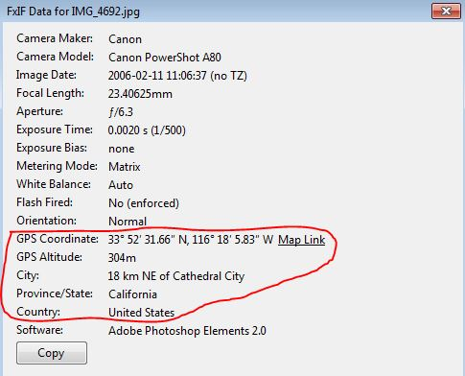
Metadata Analysis ( Images )
Within files there is usually some hidden data which is stored, this data is called metadata.
Image files store EXIF ( metadata ) which has many fields, including the coordinates where the image was taken, which is very useful to investigators.
The infamous hacker Hector ‘Sabu’ Monsegur was caught after he uploaded an image to twitter without wiping its EXIF data.

Slide 7
How To Not Get Caught
Using a RAM based operating system like Tails OS and setting your bios to erase your RAM on boot and shutdown
If you have stored incriminating files on your system, detach the HDD and drill holes through the disk and microwave it
Use common sense and do not download random files onto your computer
Erase metadata from all of your image files before posting them or sharing them with anyone

Slide 8
Thank you for your time

